Slide 1
Creating Components
Elaborated by: Douglas G
douglas@Ideliver-inc.com

Slide 2
Agenda
How to Create a Business Component
What is a Business Component?
Manual Implementation of a BPT Component
Convert Manual test into a Manual Component
Demo
Exercise
Questions

Slide 3
What is a Business Component
It is a reusable unit comprising one or more steps that perform a specific task
Notes:
A Business Component is a reusable unit comprising one or more steps
that perform a specific task. Components are the building blocks of
business process testing

Slide 4
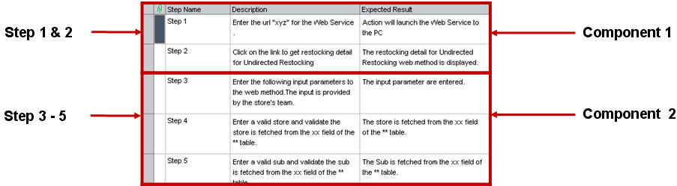
Business Component Example

Slide 5
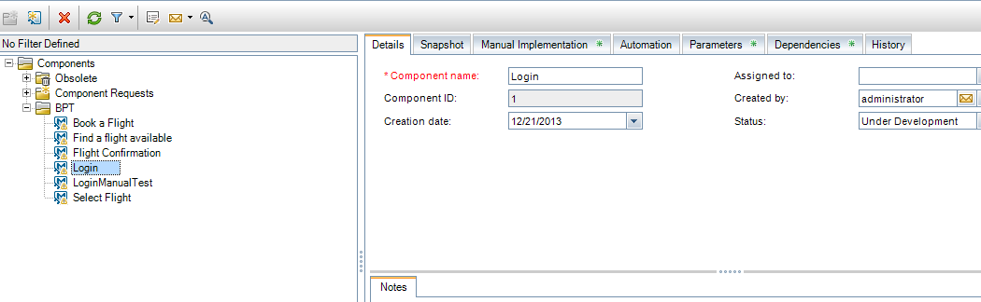
How to Create a Business Component?
Go to the Business component Module
Click “New Component”

Slide 6
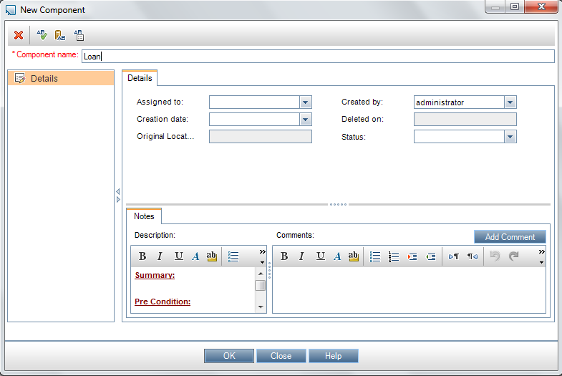
How to Create a Business Component(Cont.)?
New component Dialog Box

Slide 7
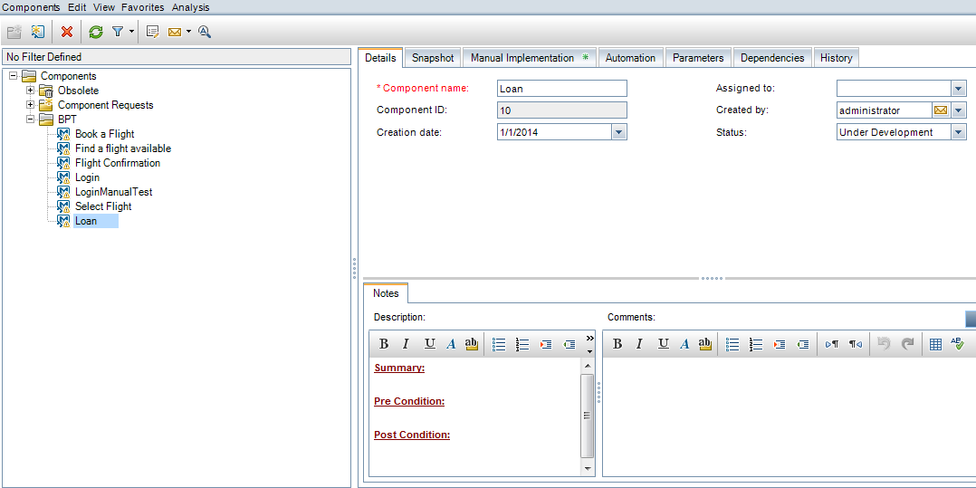
How to Create a Business Component(Cont.)?
The new component will be added to the component tree

Slide 8
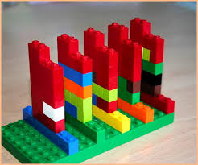
Manual Creation of a Business Component

Slide 9
Steps
Steps represents operations
The manual steps defined in the components are performed

Slide 10
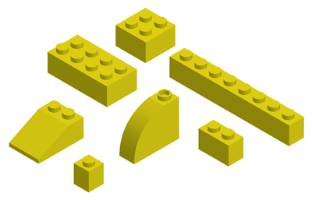
How to Work with Manual Components?

Slide 11
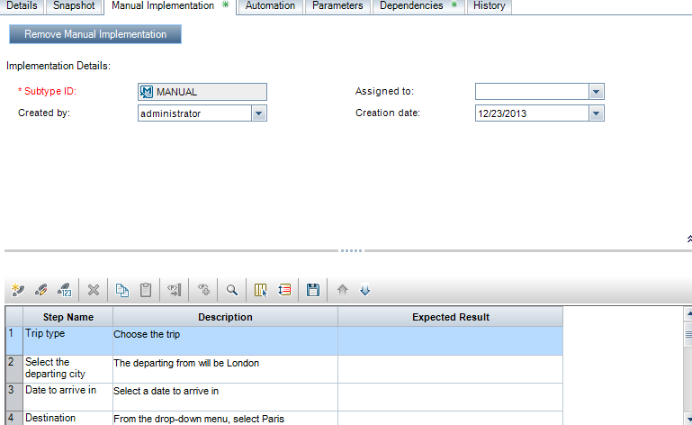
1) Add Steps
Go to “Manual Implementation”
Click “Add Steps”
1
2

Slide 12
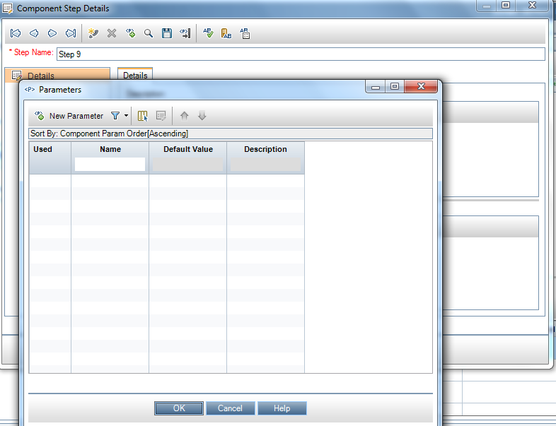
2) Parameterize Steps - Optional
Click “Add parameters”
Click “New Parameter”
1
2

Slide 13
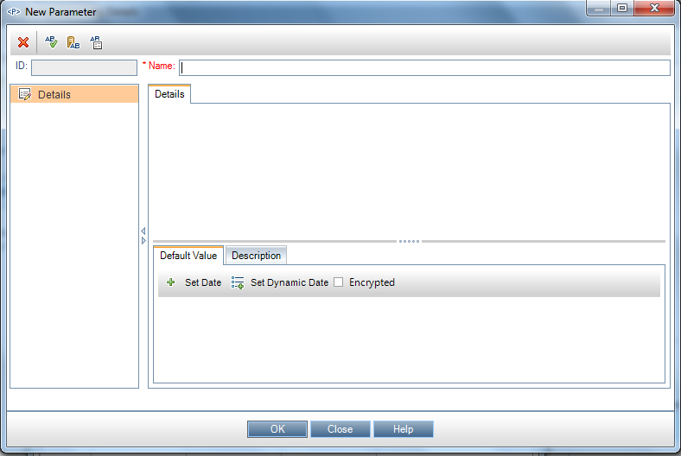
New Parameter Window

Slide 14
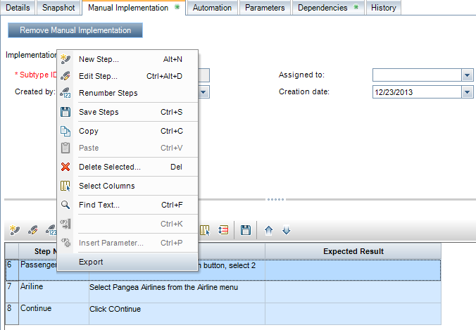
3) Export Steps - Optional
Select the steps
Right click and then choose “Export”

Slide 15
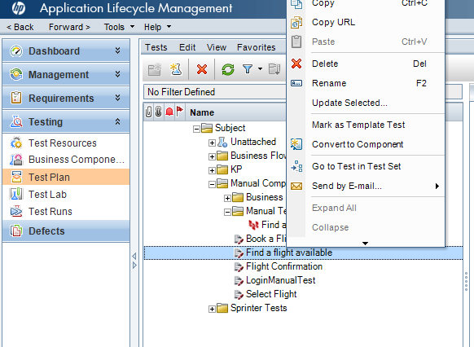
Convert Manual Test into a Manual Component
Go to the Test Plan Module
Select a manual test
Right click and select “Convert to Component”

Slide 16
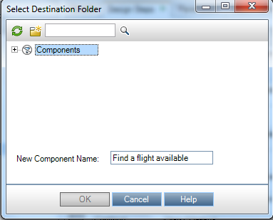
Convert Manual Test Into a Manual Component(Cont.)
Select the destination folder
Define a new for the new component

Slide 17
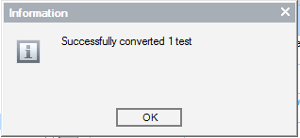
Convert Manual Test Into a Manual Component(Cont.)
When ALM converts the component, you will receive a message

Slide 18
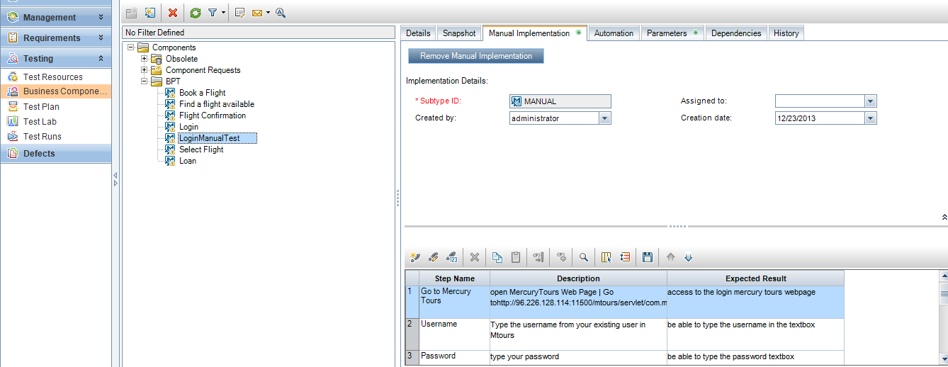
Convert Manual Test Into a Manual Component(Cont.)
The new component will be listed under the component tree from the Business Component module

Slide 19


Slide 20

Exercise

Slide 21
Questions

